Slide 1





Final Presentation
PRESENTED BY: BLITZ-DRIVE
1
Notes:
aritra - open up the presentation

Slide 2





CONTENT
01
02
03
04
About Us
Project Plan
Project Objectives
Hardware
05
06
07
08
Hardware Testing
Software
Mechanical Design
Final Testing
2
Notes:
aritra - present the topics we are going to talk about

Slide 3


ABOUT US
Artira Biswas
(Group Leader)
Nghia Hoang
(Documentation Lead)
About The Project
Dung Phan
(Quality Controller)
Jimmy Tithphit
(Process Controller)
The main goal of this project
is to make an autonomous car
that meets the requirements
Mathieu Geiller
(Research Lead)
3
Notes:
all of us

Slide 4







PROJECT TIMELINE
02
04
06
Create a project plan
Assemble the components
Finish the car
01
03
05
Gather ideas and brainstorm
Create the designs (Functional and Technical)
Integrate the code and the breadboard connection
4
Notes:
Nghia - Here is the timeline of our project. We first had to gather and brainstorm together ideas about the project, for example what components we would use, what would they do.
Then we made a project plan, this is where the project started taking shape. We talking about our main objectives and what were the steps we were going to take to arrive at our final product
The third part of our project consisted of testing the components and making changes to them, we had to also order the components we didn't have. Then after testing and tweaking with the car, we wrote reports, the functional and technical design) about what we did.
After getting our components we then assembled them as well as printing out the 3D design for our car.
Before we finished the car, we have to then integrate the code of all the separate task that the car was going to do into one block of code as well as connecting all the components together.
The final step will be to see how our car will be able to perform on the track.

Slide 5

PROJECT PLAN
01
Finding the suitable components
02
Spending based on given budget
03
Planning and communication between members
04
Finishing the project
5
Notes:
nghia -
We first create a plan and all the designs we need for our project. From there we could find out which components we need for each functionality part of the car that it has to achieve.
We were given a limited amount of budget to spend on our missing components, which we have to do researches on each component on a number of websites to compare their prices. After that, we would choose the components we need based on our budget limit without exceeding it.
For the course of the project, we have to have occasional meetings every week to keep up with the project workload. In each meeting, we have to have clear communication in order to work effectively and achieve the predetermined work target for the week.
After every implementation of both hardware and software parts on the car, and fully testing it, we can finally test our car and see the results.

Slide 6


OBJECTIVES
Objective 1
Objective 2
Objective 3
Objective 4
Detect and follow a given line.
Stopping at the end
of the line.
Detecting and avoiding
obstacles.
Adequate power sources
for the car.
6
Notes:
Jimmy - talk about our objectives.
1: The bare minimum to pass the project is to follow the line
2: The car must stop automatically when arriving at the end of the track
3: The extra objectives are to detect and avoid obstacles such as an object on the track and a slope to climb over
4: The car must run for a minimum of 30 mins

Slide 7
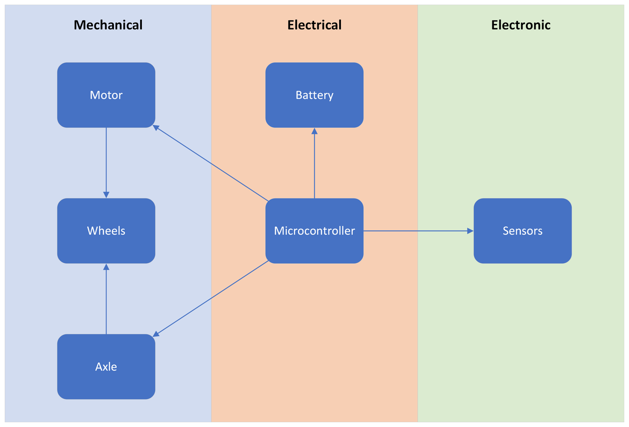
BLOCK DIAGRAM
7
Notes:
aritra - Here is the block diagram where we divide it into 3 sections: Mechanical, Electrical and Electronic.
In each section we have ... (read the blocks)
The arrows show the relationship between the different components

Slide 8
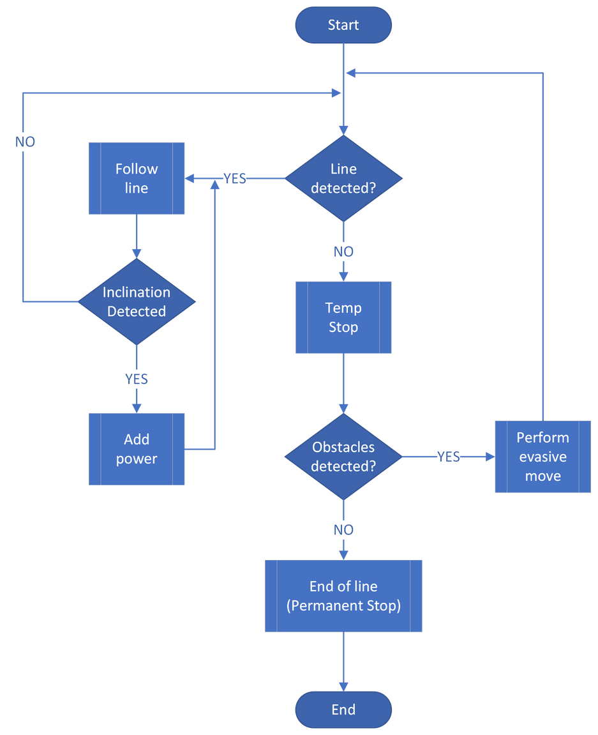
FLOWCHART
8
Notes:
Mathieu - Ill just describe the flowchart its fine.

Slide 9
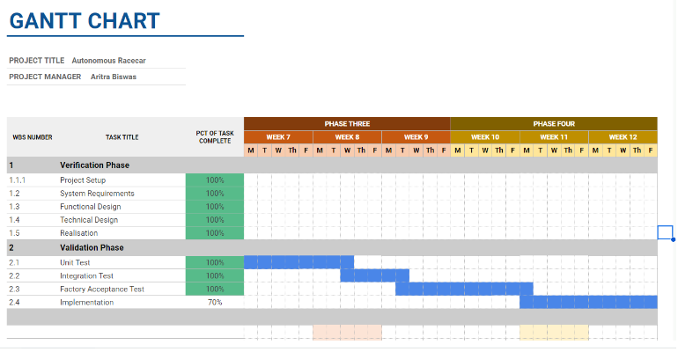
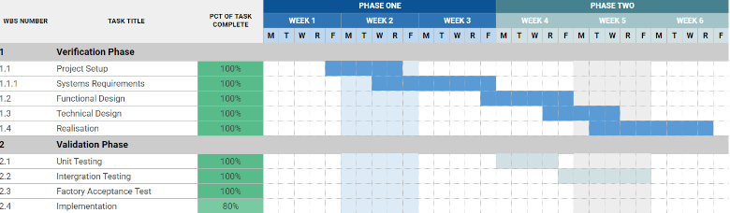
GANTT CHART
9
Notes:
Mathieu - Here we have the gantt chart for our group, we have dispersed our task along 13 weeks that our project will be lasting for different topics.
On the side we can see the completion rate for each of the different steps. So far we have completed most of the task in the period of time we assigned ourselves.

Slide 10
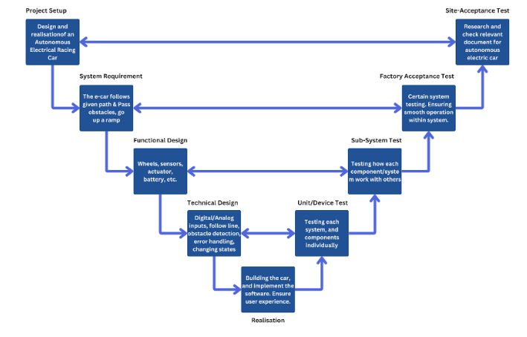
V-MODEL
10
Notes:
nghia
The V-model describes what each process does and how they correlates with each other in the project
Project Setup: The group has to design and create a functional autonomous electrical racing car
Site-acceptance Test: The group do relevant researches related to the autonomous car
System Requirement: The car has to follow the white line, pass the obstacle and go up the ramp
Factory Acceptance Test: The group has to do system testing to make sure the car functions normally without any defects
Functional Design: The group creates a design on which components to choose over several available options based on their traits
Sub-system test: The group then checks if each component would work well with each other
Technical design: The group creates the code for each function: follow the line, avoid the obstacle, …
Unit/Device test: The group checks if there is any defects with separate components such as the wheels, motor and the Servo
Realisation: The final assembly of the car and also the implementation of the software into the car to make it functional.
Moreover, the user experience needs to be ensured at the highest level.
Could be split into half

Slide 11
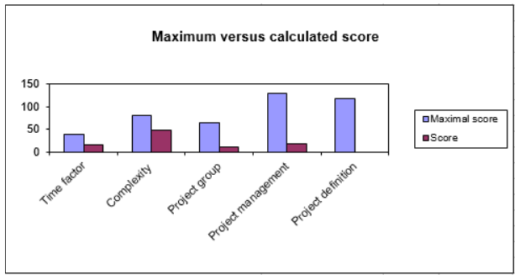
RISK ANALYSIS
11
Notes:
Jimmy - The initiator for this project wants a limited risk analysis done before the initiation of the product phase of this project. In a limited risk analysis, the client or initiator is aware of the maximum level of loss that they can expect during the execution of this project. According to the ‘risk analysis’ survey by Project Management book by Roel Grit, our risk percentage for this project was 22.17%. The survey consisted of risk assessment on various factors such as
Time factor:
Whether the project had deadlines and how suitable were the deadlines to complete the project.
Complexity:
How complex the task and subtasks given in the project are.
How related the current project is compared to the previous project so that experience plays a significant role.
Coordination in the complexity.
Project Group:
How competent and experienced the group members are in the projects.
How compatible roles within the group are created.
Project Management:
How much experience project leaders, managers and advisors have.
Is existing knowledge/experience used or anything more required.
Project Definition:
Is the scope sufficiently defined?
Is the goal, objectives and problem statement clear for all group members.

Slide 12

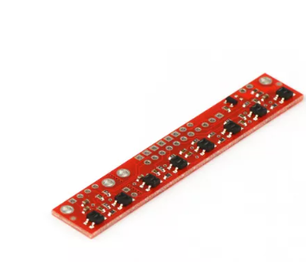
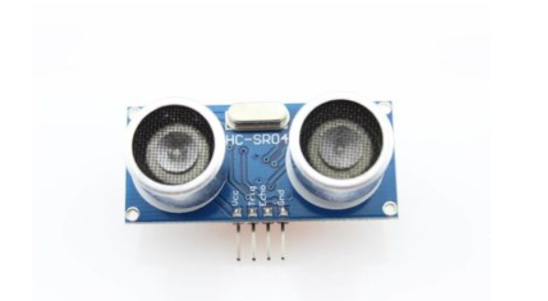
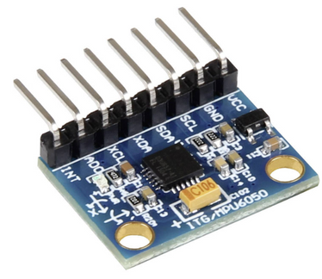
HARDWARE
Ultrasonic Sensor
We chose the HC-SR04 sensor because of it’s price and reviews about it
Gyroscope Sensor
We were debating between a tilt sensor and a gyroscope, and decided to go with the MPU6050 as it was more accurate with the readings
Reflectance Sensor
We went with the QTR-8A as it matches with our preferences and it was within our budget.
12
Notes:
mathieu - Here are the different components we chose to realize this project.
The first component is the Ultrasonic sensor, we chose the HC-SR04 due to it's price, reviews and tutorials available online.
The second component we got is the gyroscope sensor. We first wanted to use a tilt sensor but after testing the ones we had, it would take a tilt of 90 degrees to detect an inclination. So in the end we went with the MPU6050.
The last sensor we chose is the IR or reflectance sensor, we went with the QTR-8A as it has a good number of information available and the price was within our budget.

Slide 13
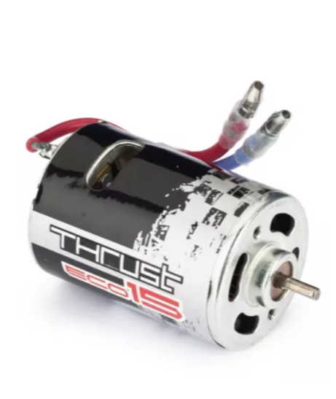
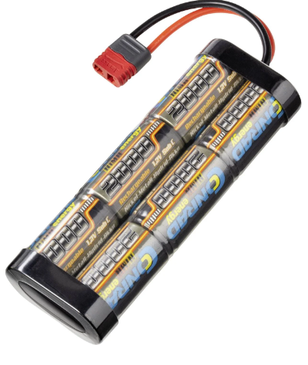
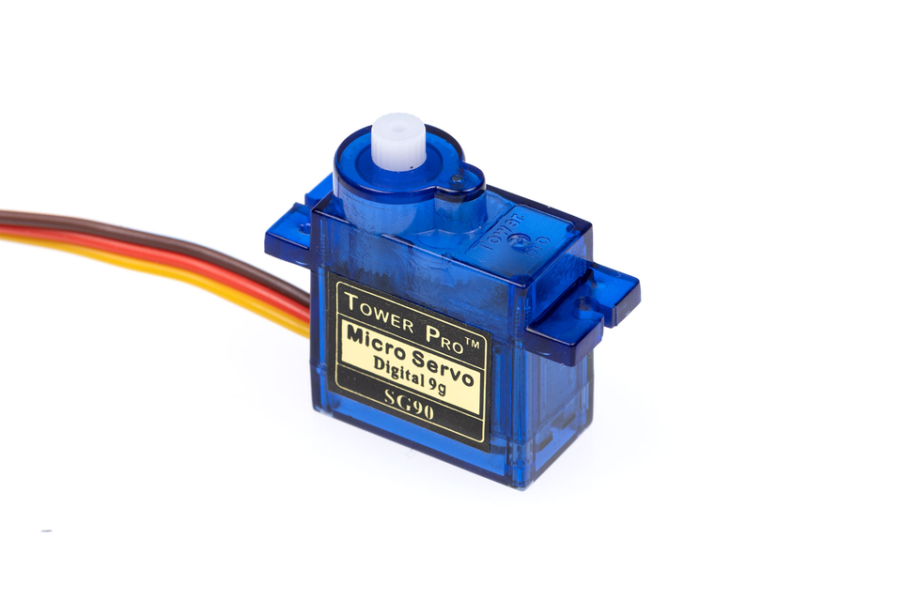
HARDWARE
Eco Thrust 15 Motor
For our motor, we got the Eco Thrust 15 motor, as it was already included inside the car and it fits with what we needed.
Conrad Battery
The Conrad energy NiMH battery pack 7.2 V 2000 mAh is the one that we chose, the main reason is that this battery pack can last up to 40 minutes as we calculated, which is what we need.
Servo
The Servo serves as the maneuvre component for the car as it controls the axle to make the car turn both ways
13
Notes:
mathieu - Next we had the motor, we just kept the motor that we first assigned with to get better options with other components with the money we saved. We went with the ECO thrust 15.
The battery, which is the Conrad Energy battery pack 7.2V, was also the same as the one we were provided for the same reasons that were mentioned previously about the motor. Plus the battery pack would last up to 40 minutes which was more than the 30 minutes we were said that it needed to last.
Finally we also kept the servo but due to some hardware issues we decided to use one of our group members servo by replacing the one we were given. And up until now we have had no issues with it.

Slide 14
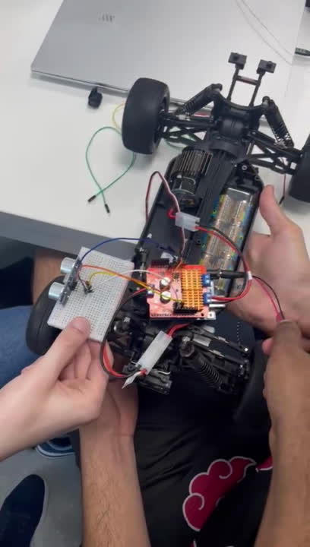
HARDWARE TESTING
Ultrasonic
This video indicates on how the ultrasonic detect an obstacle and make the car stop.
14
Notes:
jimmy - by placing an object in front of the Ultrasonic, we can detect and print out the distance that object is away from the car

Slide 15
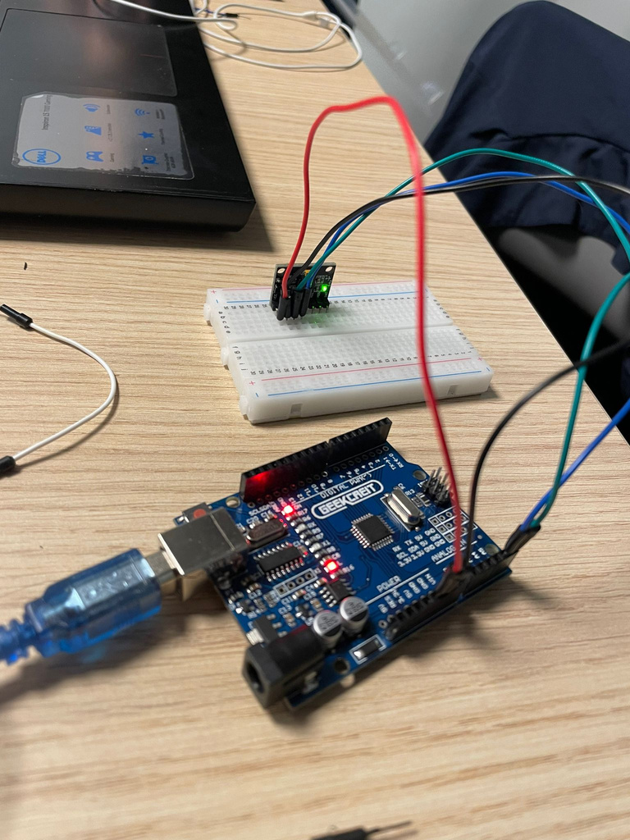
HARDWARE TESTING
Gyroscope Sensor
This picture show the process of using the gyroscope to detect the inclination of the car when it goes up the ramp.
15
Notes:
jimmy - To test the gyroscope we gave it a function, when an angle of a certain degree is being read that it would print out something. We would tilt it by grabbing it with our hands and sway it side to side to see how accurate each readings were.

Slide 16
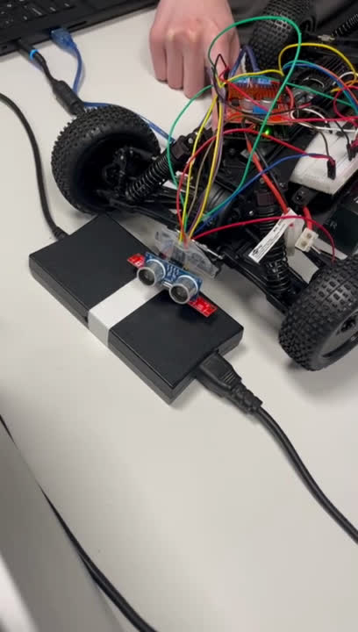
HARDWARE TESTING
QTR 8A
We’re testing the sensors for the car line detection.
16
Notes:
jimmy - Before using the QTR, we need to calibrate it so that it can use the data from its calibration to detect the white line. After calibrating we would then turn the around to see whether the wheels would turn depending on which sensor the white line would be on, so for example if the sensor of the far right detects the white line then we would turn right.

Slide 17
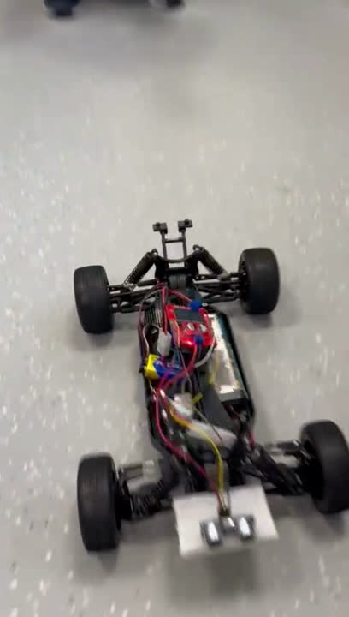
HARDWARE TESTING
Motor
The video shows the process of the car moving by using the motor to powers the car
17
Notes:
mathieu - By writing a simple code to where we can change the car speed, we can test the motor and how fast the car can go.

Slide 18
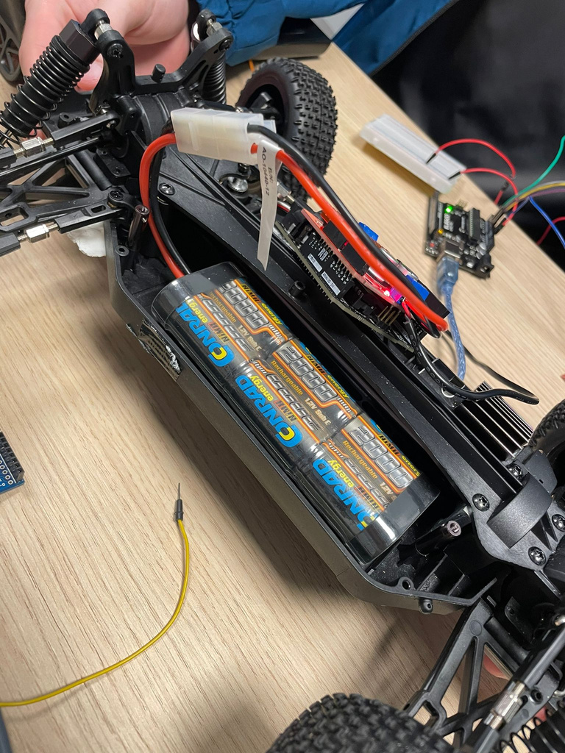
HARDWARE TESTING
Battery
The battery powers the shield to make the car runs.
18
Notes:
nghia - To see whether the battery was working, we would plug into the shield and test to see whether the LEDs would light up and the components that are plugged into the shield would be powered on.

Slide 19

ISSUES
During the project
HARDware part
19
Notes:
dung

Slide 20
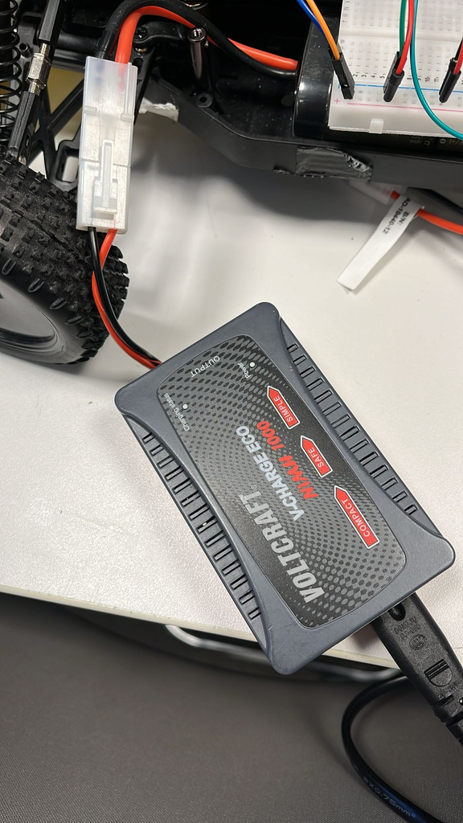
ISSUES
During the project
Hardware Part
20
Notes:
dung - We had issues with the components when we first started testing:
- Battery, when we first started charging, there was no power and it wasn't powering up the motor. We then try another team charger and still wasn't working. We then got another battery.
- Charger, we tested it with a new battery and we knew that the battery was already working as we tested it out with another teams charger. So this time the problem was the charger. The solution was to talk with the teacher where we wanted a new charger but he gave us a different approach by re-soldering the wires in the charger.
- Servo, the servo was not working with the servo unit testing code, we then replaced the servo with our servo, and then we requested for a new servo and got it.
We had a few issues along the way but most of them were resolved, the hardest issue we had was calibrating the wheels when it would take the curve on the track. It would sometimes just swerve off. But in the end, we managed to resolve the issue

Slide 21
ISSUES
During the project
Software Part
21

Slide 22
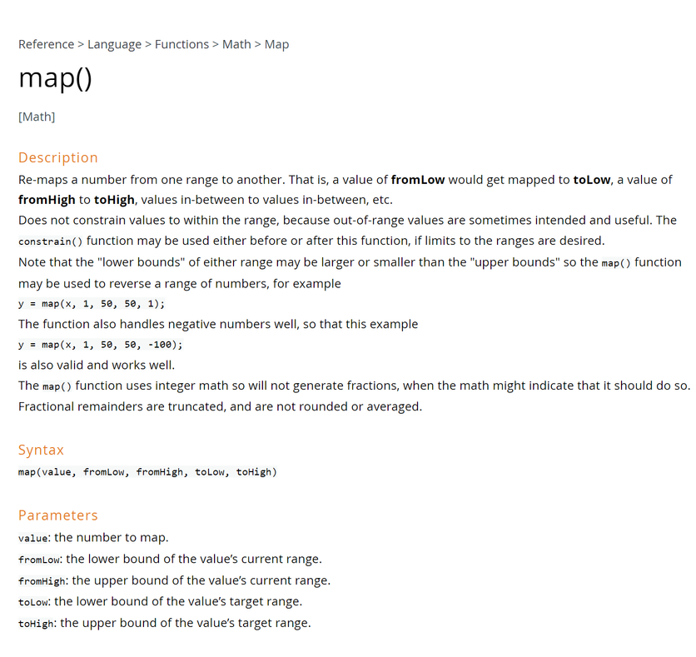
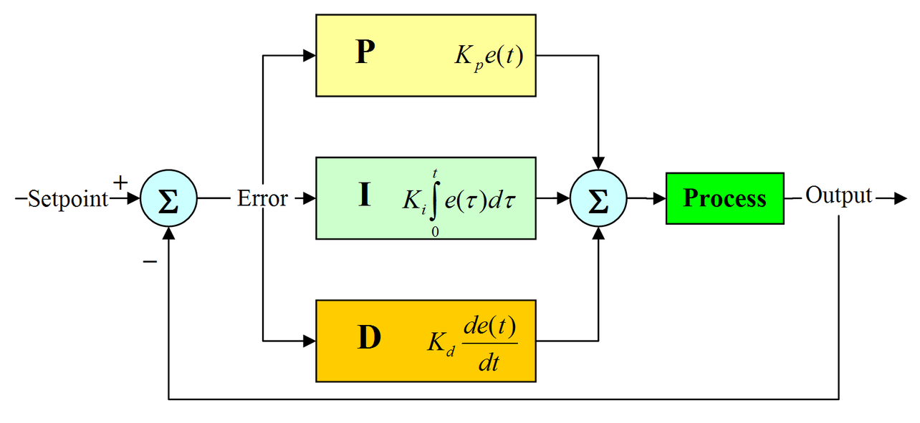
ISSUES
Formula for PID
22
Notes:
dung - We also faced issues during the coding section of our project where we had to do multiple test tries to get it correct and fix it.
QTR 8A, we had 3 options, either hard coding it, or mapping or using the PID.
The first option we had which was hard coding what the car do, basically telling the car what to do manually, it works but it is a lengthy process with a lot of trail and errors.
The second option, which was the most favorable one, was basically mapping the code by using a function, Read_White_Line(), that would take the position of the car on the line. We used this because we wanted to save time and avoid mistakes. This also gave us built-in functions from the library.
Lastly the last option has issues for example the PID fluctuates a lot, it doesn't synchronize with the speed of the car and it can't follow the line at the steepest point of the curve.
aritra - Using the map() function also posed major challenges since continuous reading of the values from the made the response to changes very sensitive to minor changes. This was also not acceptable.

Slide 23
ISSUES
After the project
Software part
23
Notes:
talk about ramp and object detection

Slide 24
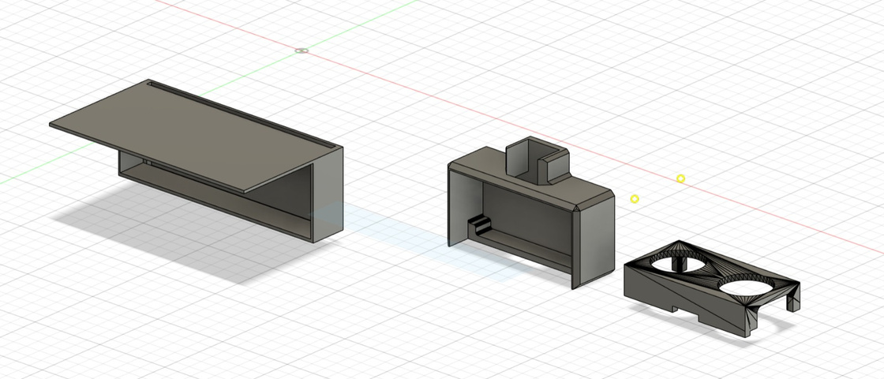
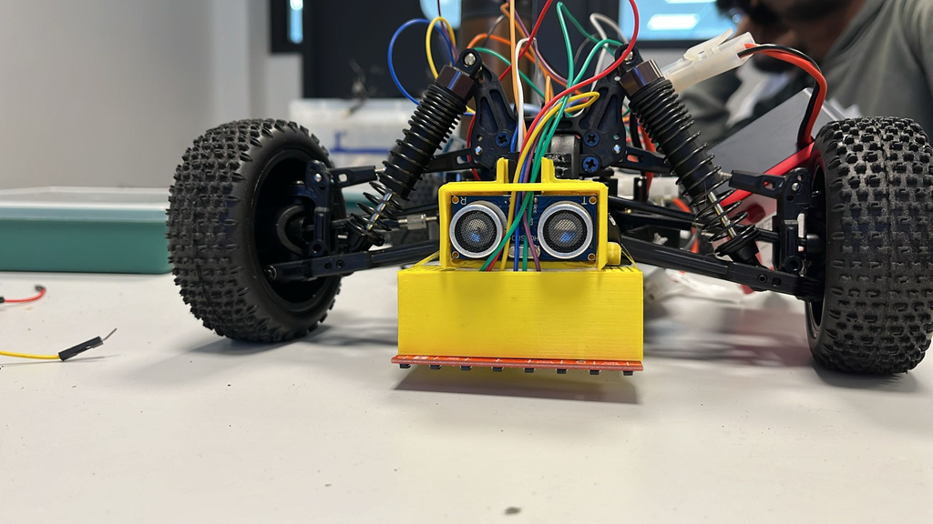

MECHANICAL DESIGN
Here is the design for the casing for our ultrasonic.
Here is the final printed out version for the casing.
24
Notes:
jimmy - This is the final design for the casing for the ultrasonic, it will fit inside the box and the covered by a lid with two holes. The holes are there to allow the sensors to peek out of the casing. We also put at small hole on top on the casing to manage our cables and let them go through in a clean way.

Slide 25
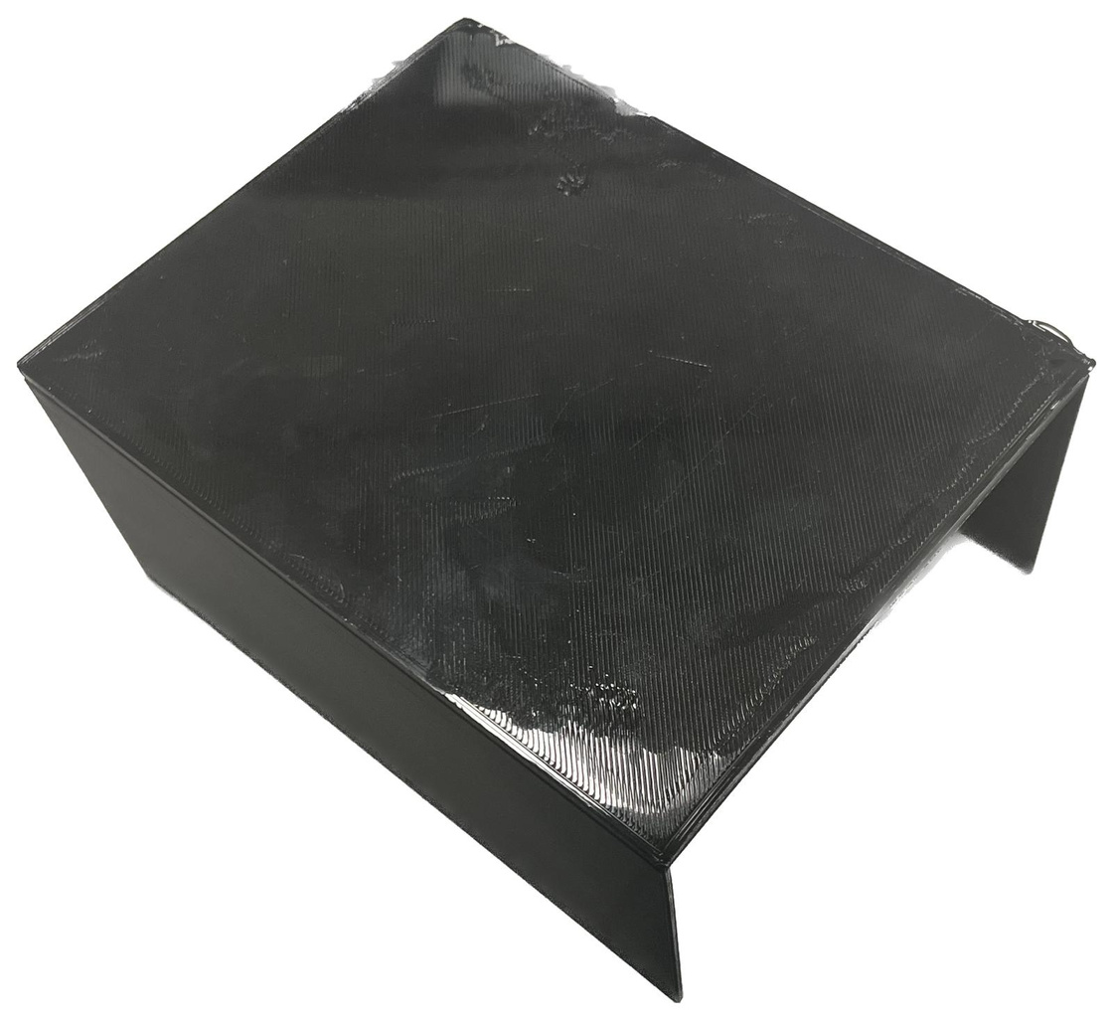
MECHANICAL DESIGN
25
Notes:
jimmy - Here we have the shell of the car....

Slide 26
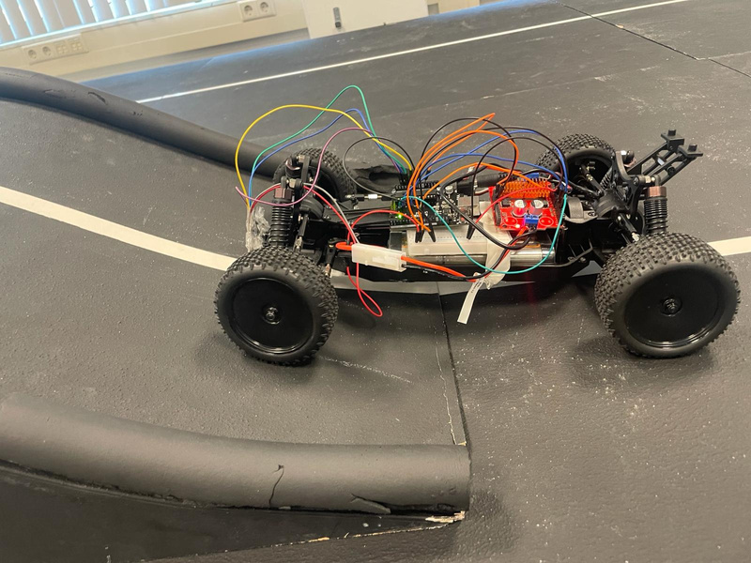

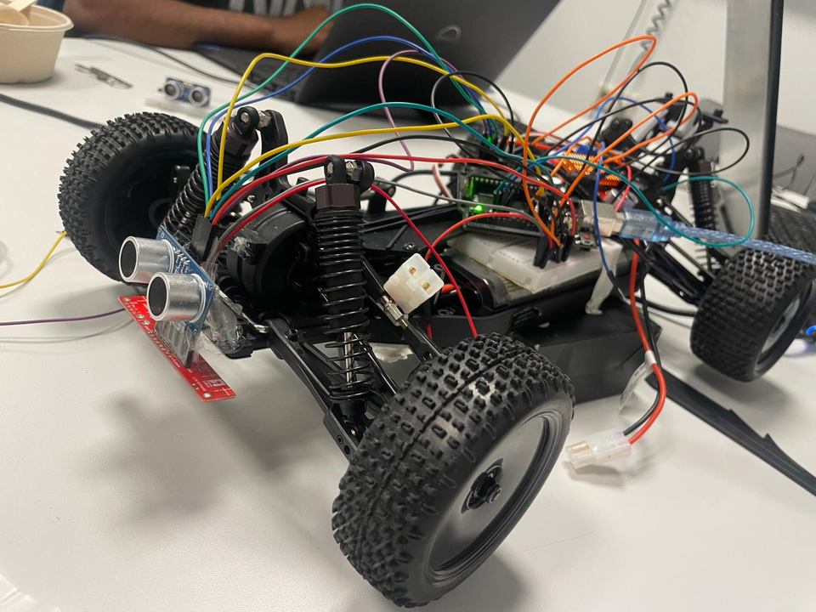
Final Testing
Before merging all the components together, we had to test whether each component would work with their specific task.
26
Notes:
nghia - The final testing serves as a way to know and test how each component will be put onto the car and test if they each do what they are meant to do. On the upcoming slide we will show you the testing we have done so far.

Slide 27
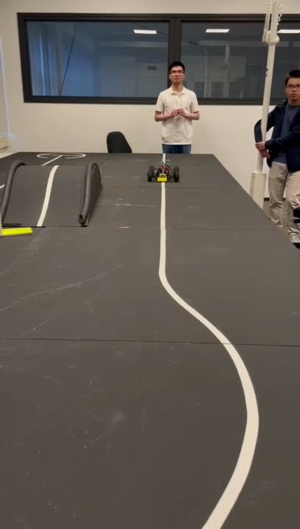
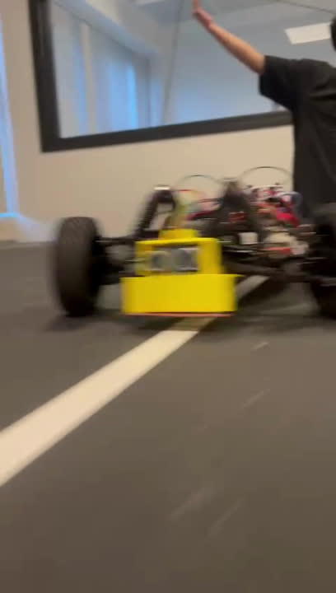
Final Testing
Car going around the whole track
27
Notes:
aritra - After compiling and finalizing the car, we then tested if the car could go around the track and here was the result:

Slide 28
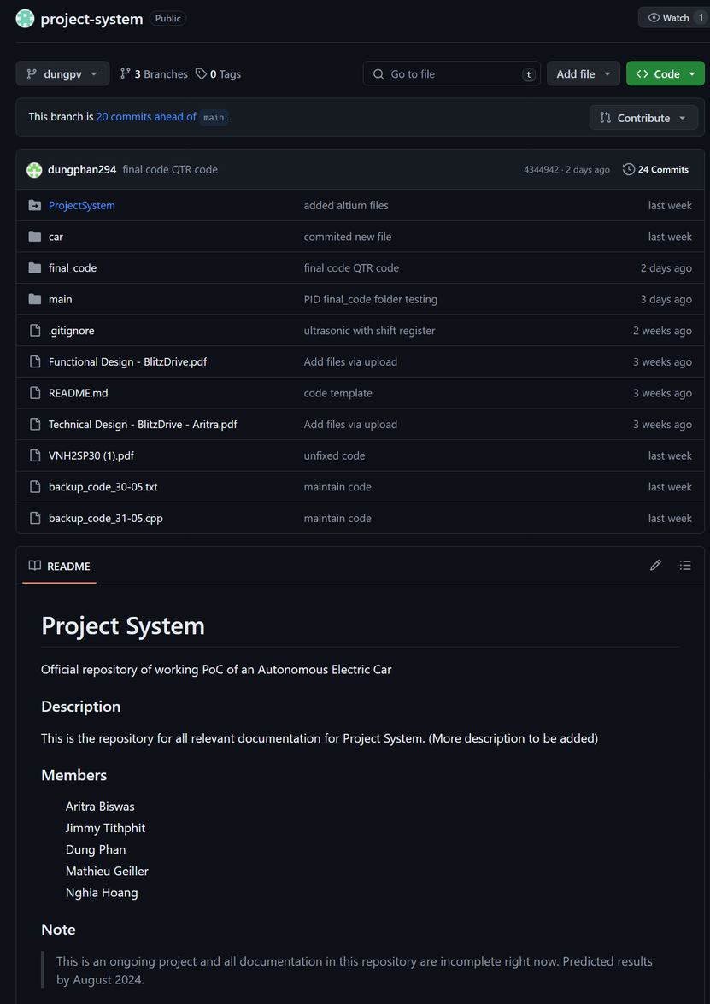
SOFTWARE
Here is the code for our github, this is where we store all the codes for our project:
link
28
Notes:
notes: open the link and let dung and aritra speak about it

Slide 29
QUESTION(S)?
29

Slide 30
REFERENCES
BlitzDrive Functional Design
BlitzDrive Project Plan
BlitzDrive Technical Design
BlitzDrive Final Report
30

Slide 31



THANK YOU!
Connect with us.
Projectstraat 1, Enschede, 7511 JX , NL
www.blitzdrive.com
+3163827384
31

